Slide 1
Web APIs and Classification
Classifying two subreddits

Slide 2


Which to follow???
Classify between Diet and Exercise

Slide 3
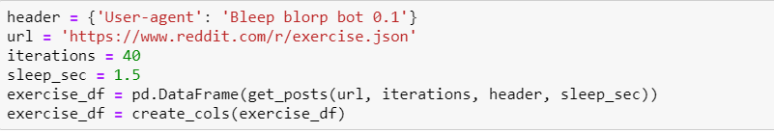
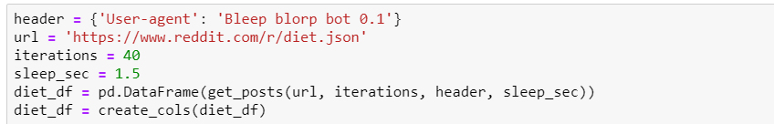
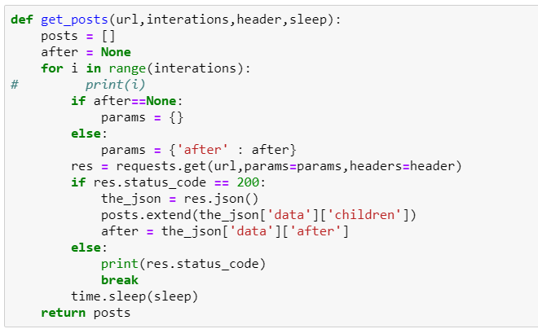
Web Scraping using Reddit API

Slide 4
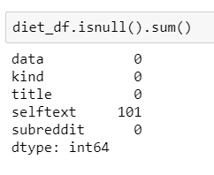
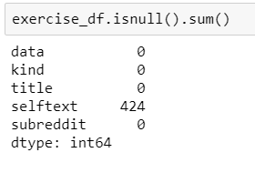
Data Cleaning
Removing Duplicate Rows
Checking Null Values
Cleaned Null values
Joined two data frames and named as final_df

Slide 5
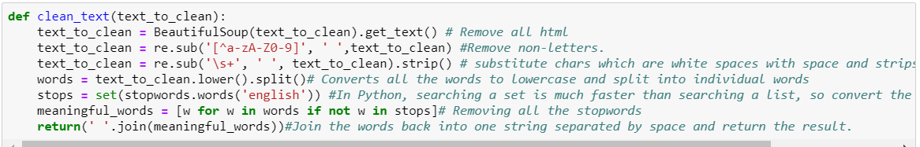
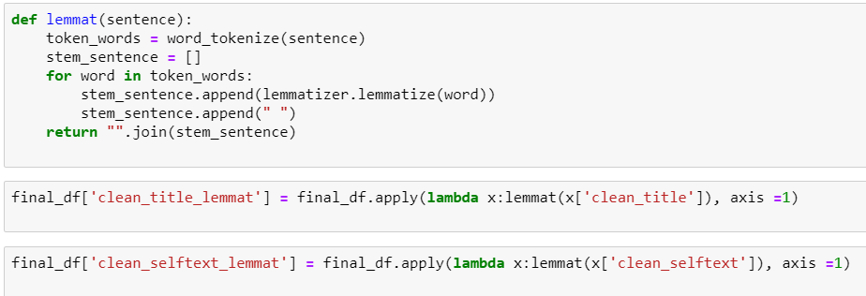
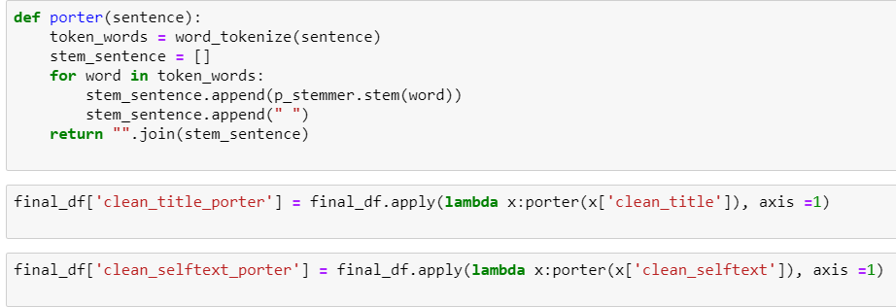
Pre-Processing
Create Label Column
Removing Space, Tab, Break line and Stop words
Lemmatizing and Stemming on selftext and title

Slide 6
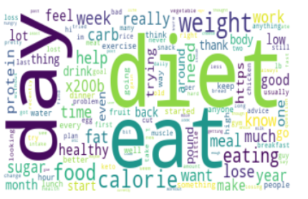
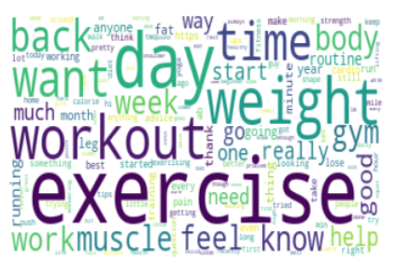
Word Cloud

Slide 7
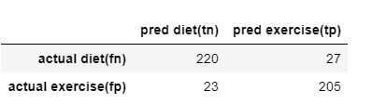
Modelling
 | CountVectorizer | TF-IDF
Logistic Regression | 84.31% | 92.71%
Naïve Bayes | 87.67% | 86.83%
Instantiating TF-IDF Using Optimal hyper parameters and Fit using Logistic Regression
Train | Test
92.71% | 89.47%
Confusion Matrix (Performance of an algorithm)
Sensitivity and Specificity
Sensitivity | Specificity
89.91% | 89.07%

Slide 8
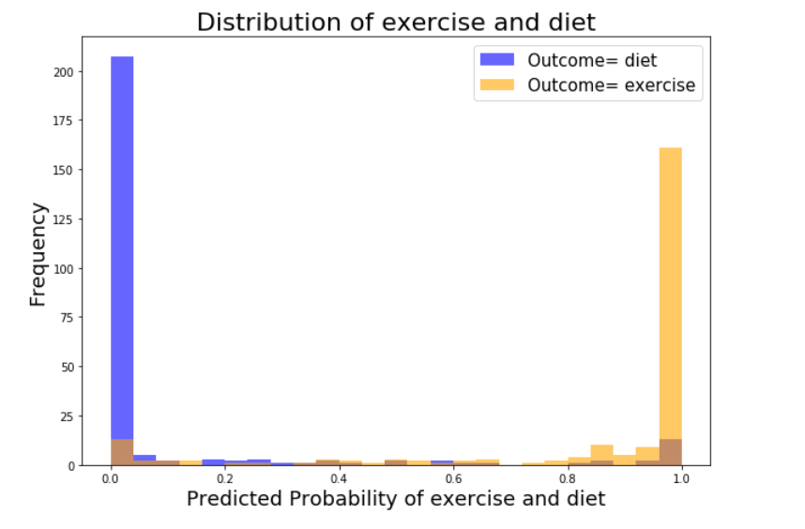
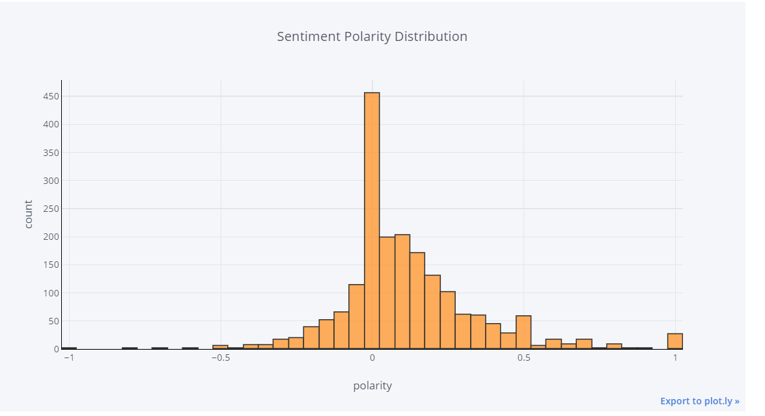
We can see the model has classified
the two subreddits very well but with
some over lappings.
We can see most of the people have neutral
sentiment and positive sentiment towards
both diet and exercise.

Slide 9
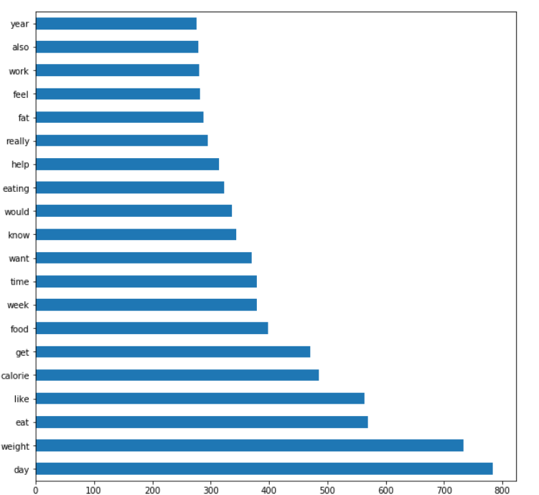
We can see most of the occurring words belong to diet than exercise. So, people talk more about it.

Slide 10
Don’t Starve!!!! Eat right type of food at the right time of the day with exercise AND Our model was able to classify the two subreddits very effectively. Thank you!!

